Slide 1
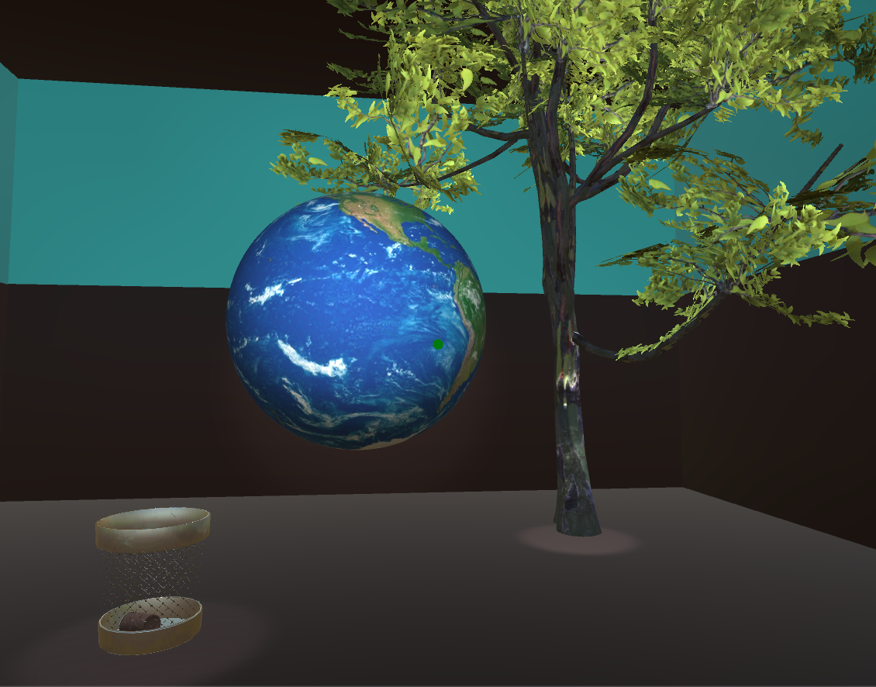
SAVE YOUR WORLD! VR
CLEA ELIASCH
MEP 2019/20

Slide 2
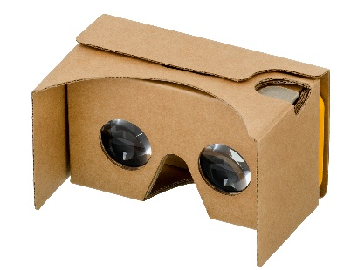

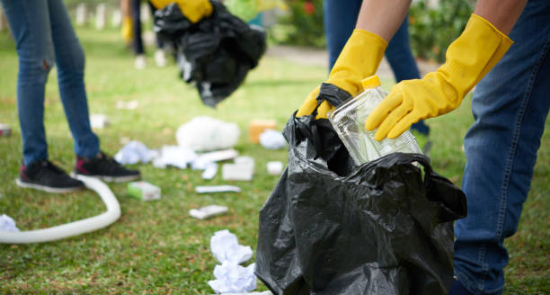
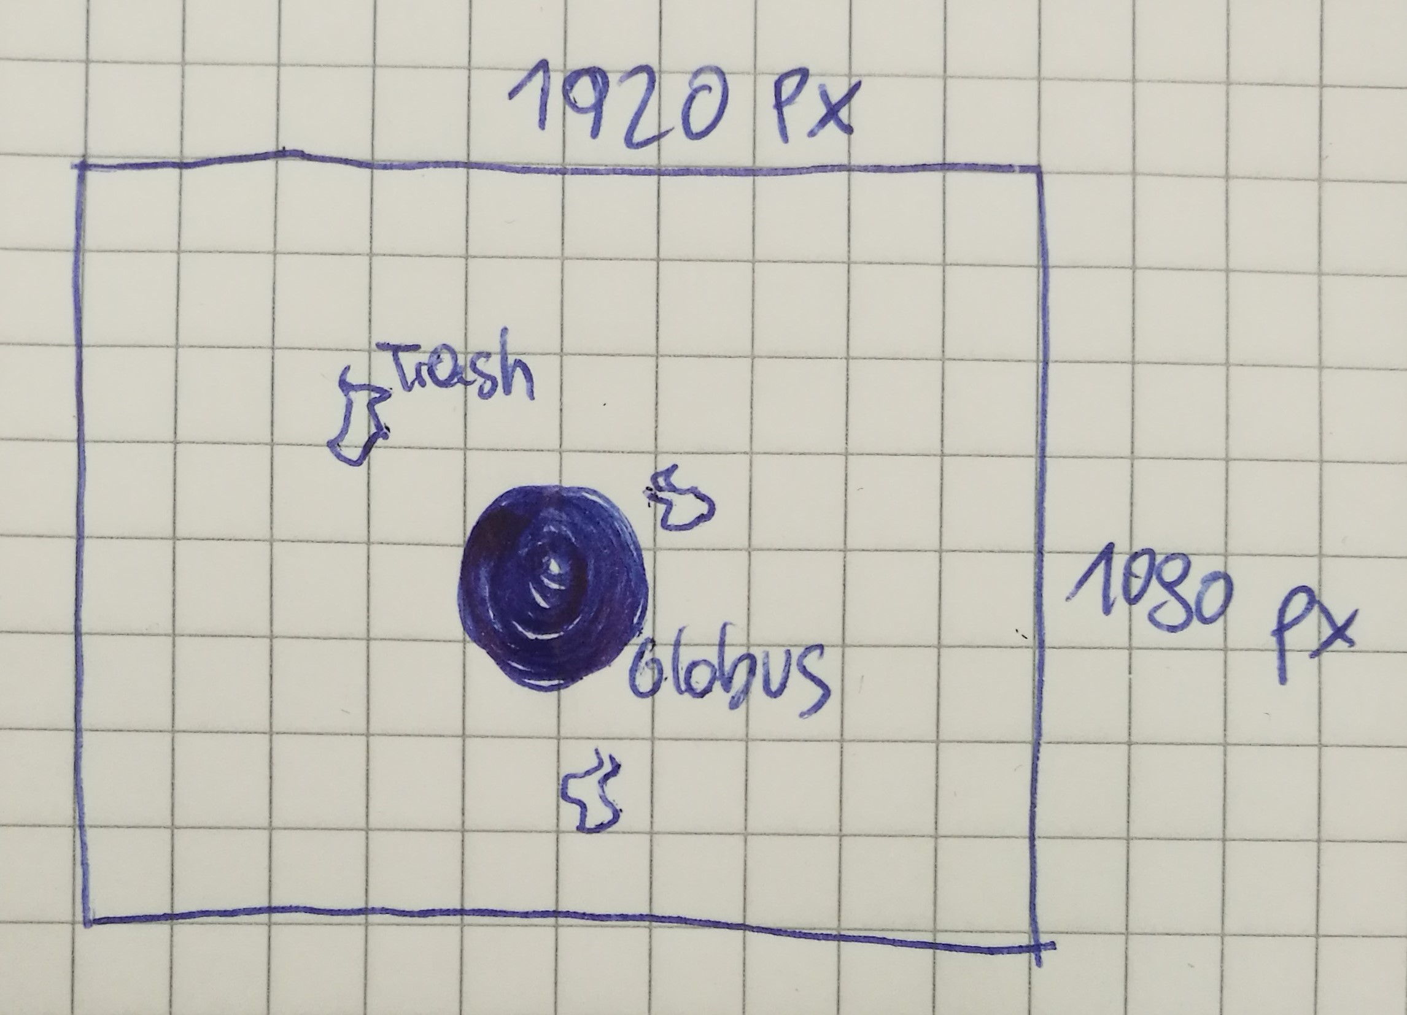
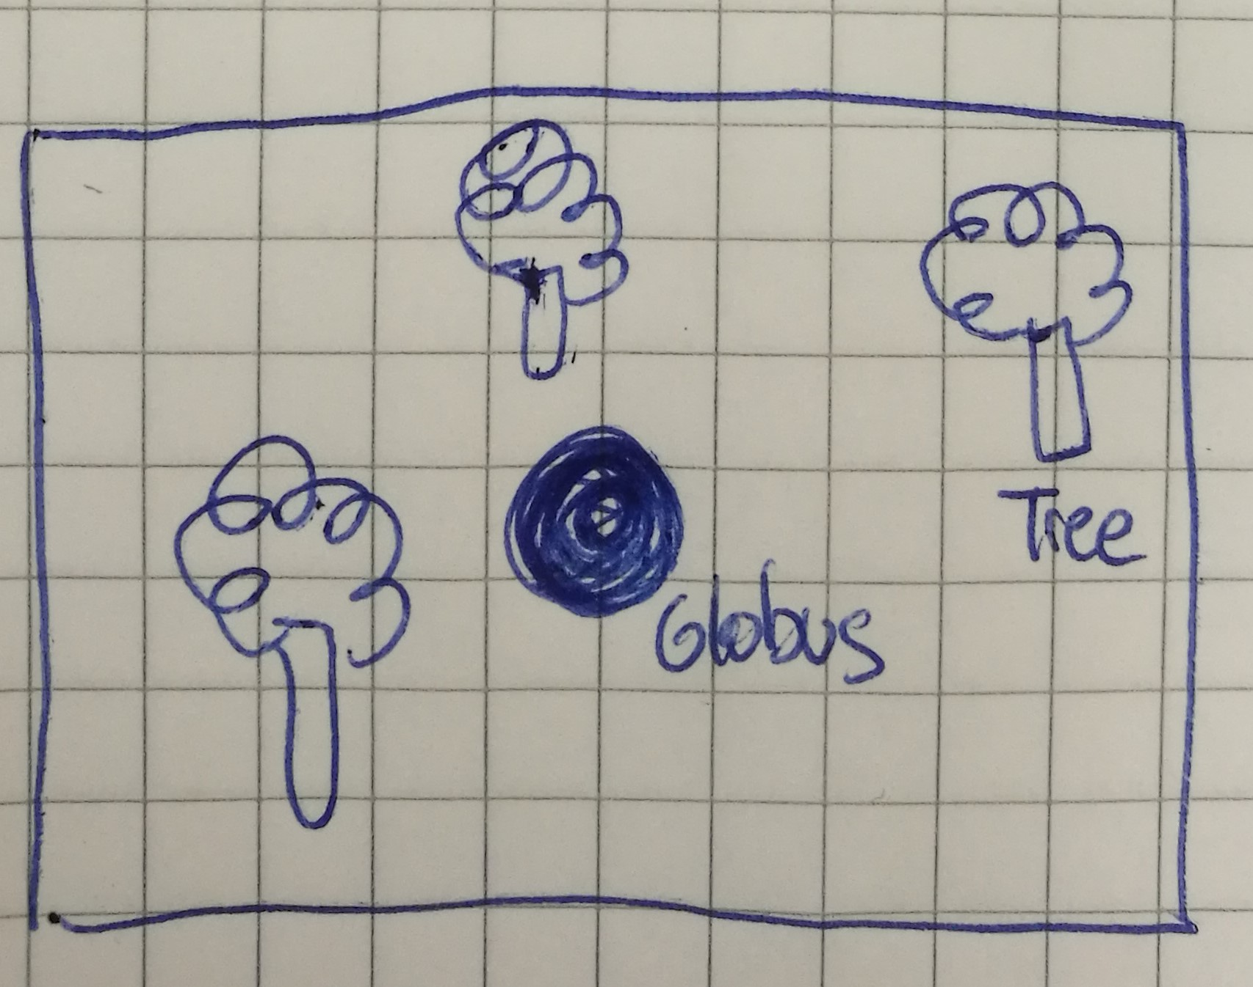
IDEA
GLOBE IN THE MIDDLE OF THE ROOM!
PICK UP TRASH TO GROW A TREE!
REPEAT THIS STEP!
GLOBE SPINS, WORLD IS SAVED!

Slide 3
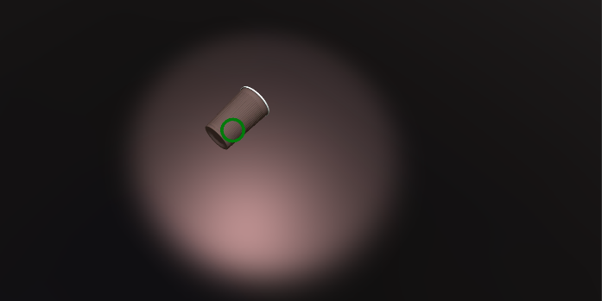
CONTROLS
MOVE BY LOOKIN IN A DIRECTION + PUSH THE BUTTON
PICK UP/RELEASE TRASH BY LOOKING + PUSH THE BUTTON

Slide 4
STARTING POINT
NEVER ever FINISHED a single VR GAME
NEVER WORKED with CARDBOARD
VIRUS on LAPTOP (&Browser)

Slide 5
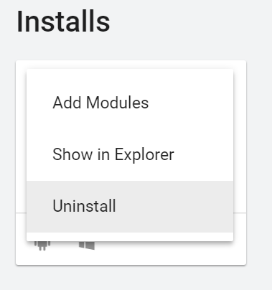
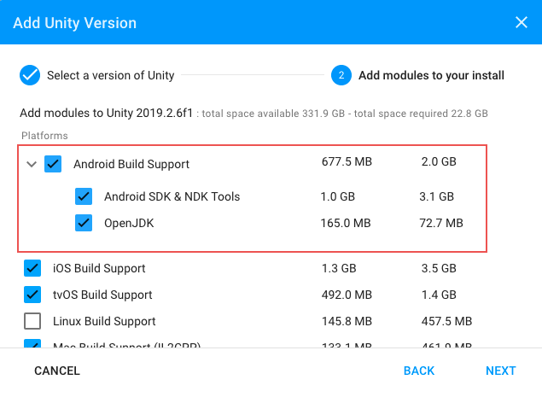
SETUP
Install GoogleVR, Android Build Support and the Android SDK & NDK tools

Slide 6
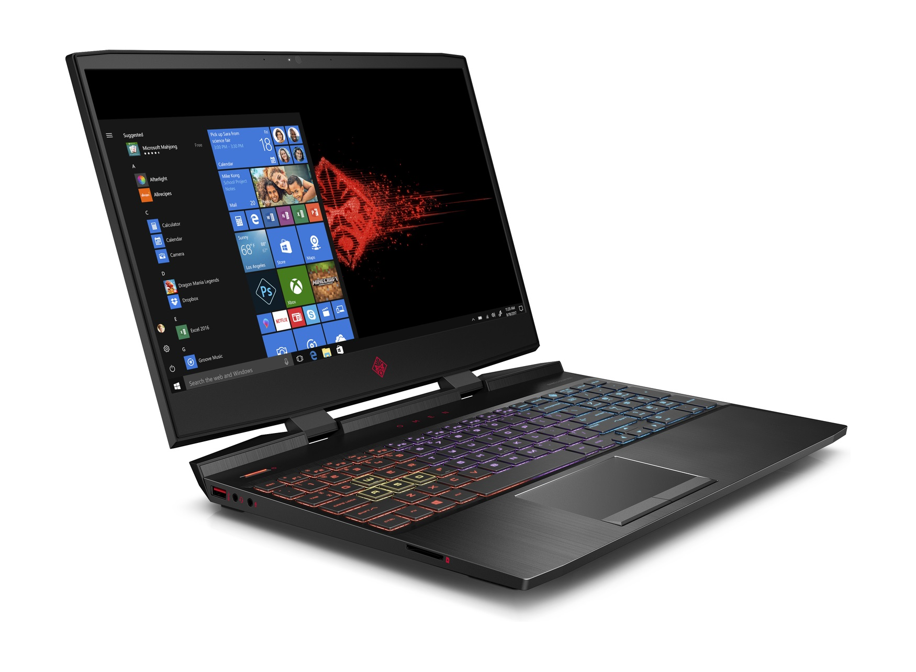

SETUP
Install Android Build Support and the Android SDK & NDK tools
CMD C + CMD V

Slide 7
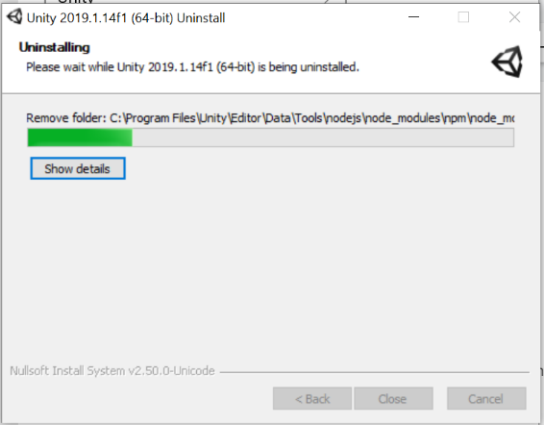

SETUP
UNITY HUB

Slide 8
SETUP
UNITY
??? 2x ???

Slide 9
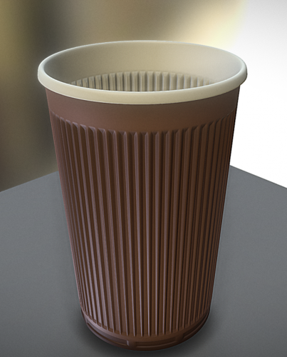
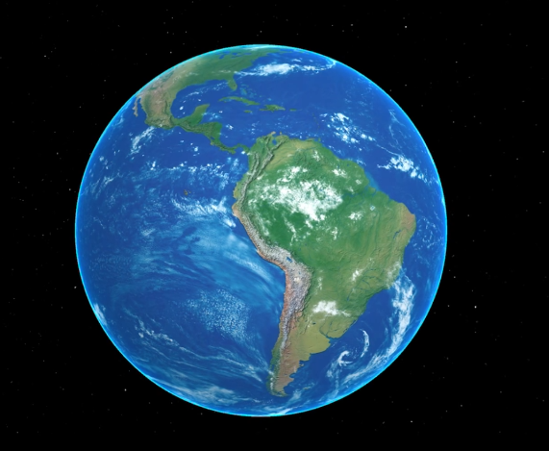
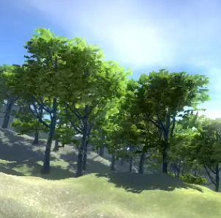
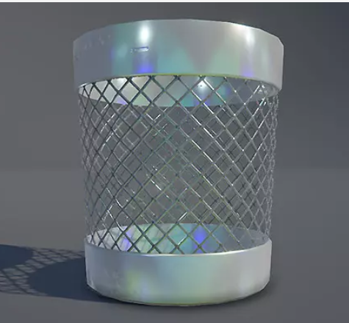
BUILD SCENE
1. White Boxing
2. 3D Models: Asset Store, free3D.com

Slide 10
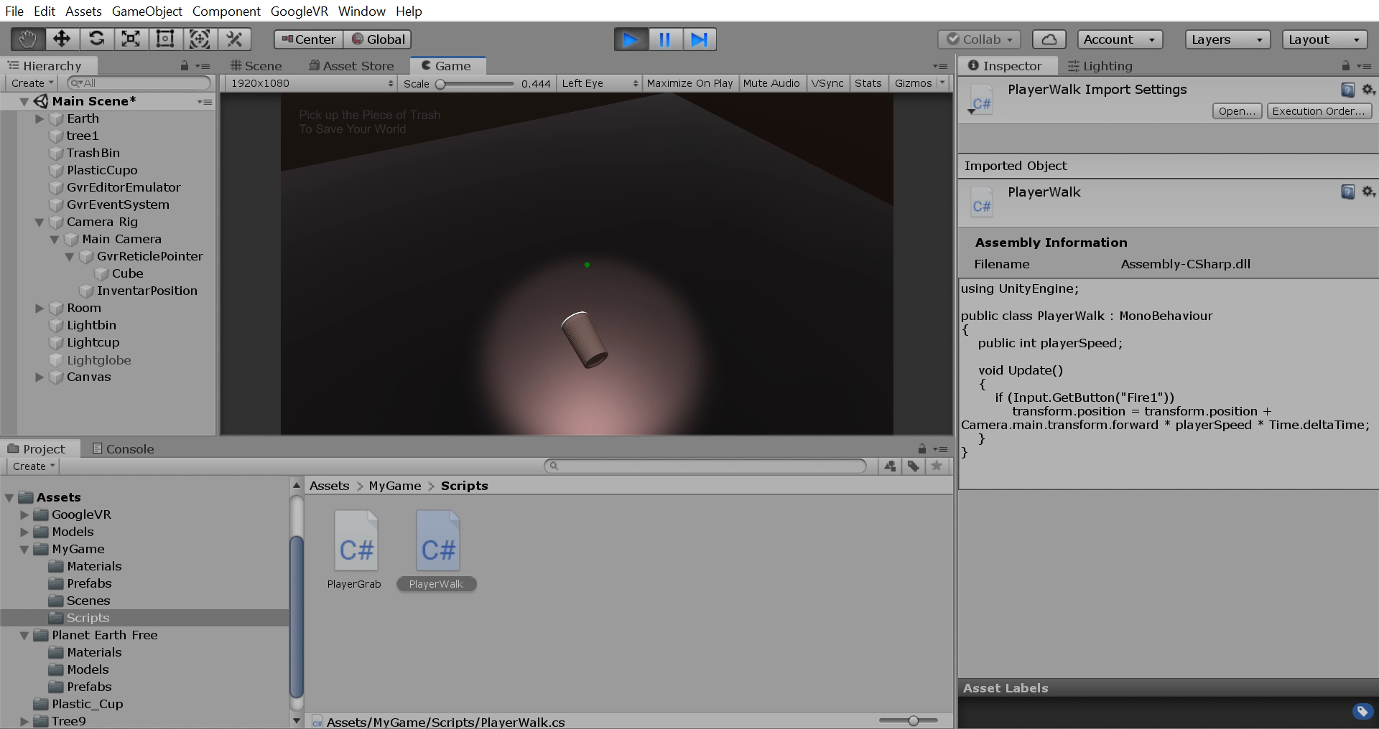
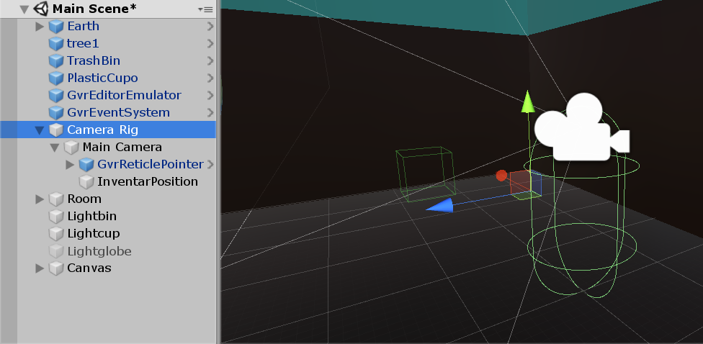
PLAYER
Camera Rig
Pointer (Problem!)
Movement

Slide 11
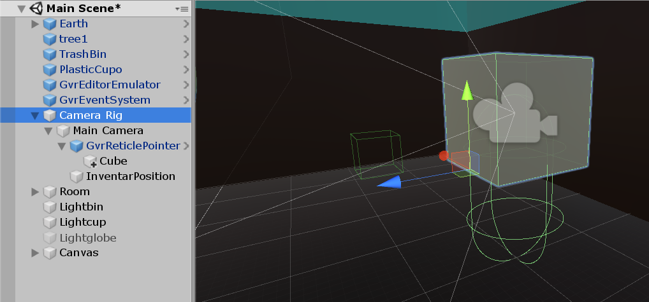
PLAYER
Camera Rig
Pointer (Problem!) -> Cube
Movement

Slide 12
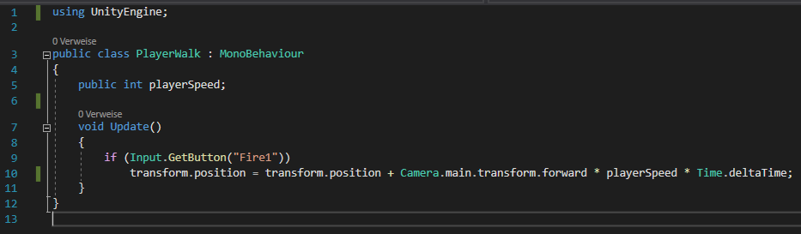
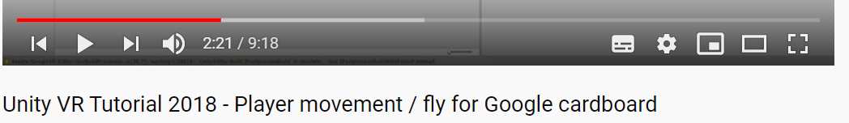
PLAYER
Camera Rig
Pointer (Problem!)
Movement
https://www.youtube.com/watch?v=Qgpb5QzhuOg&list=PLiuDBLn1FK-QOmpA3Vs2JY0DVAj0GfFPn&index=2

Slide 13
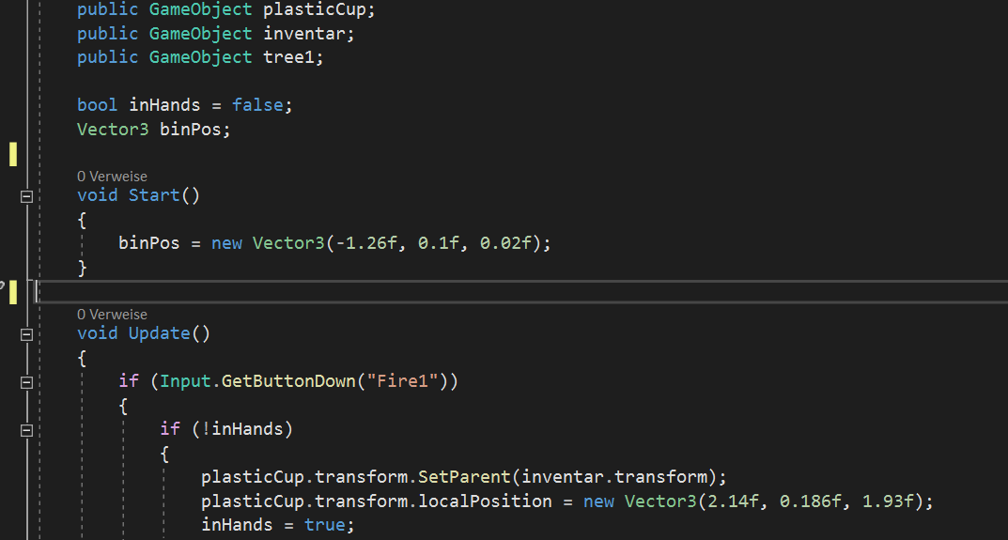
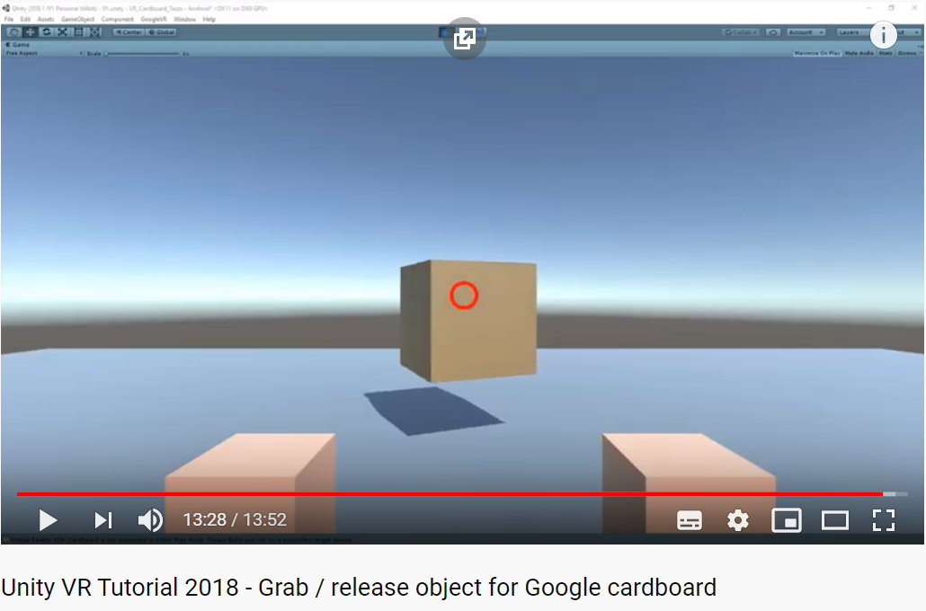
SCRIPTS
PlayerWalk
PlayerGrab
SpinFree (3D Model Globe)
https://www.youtube.com/watch?v=wWSYT-Yrr9E

Slide 14
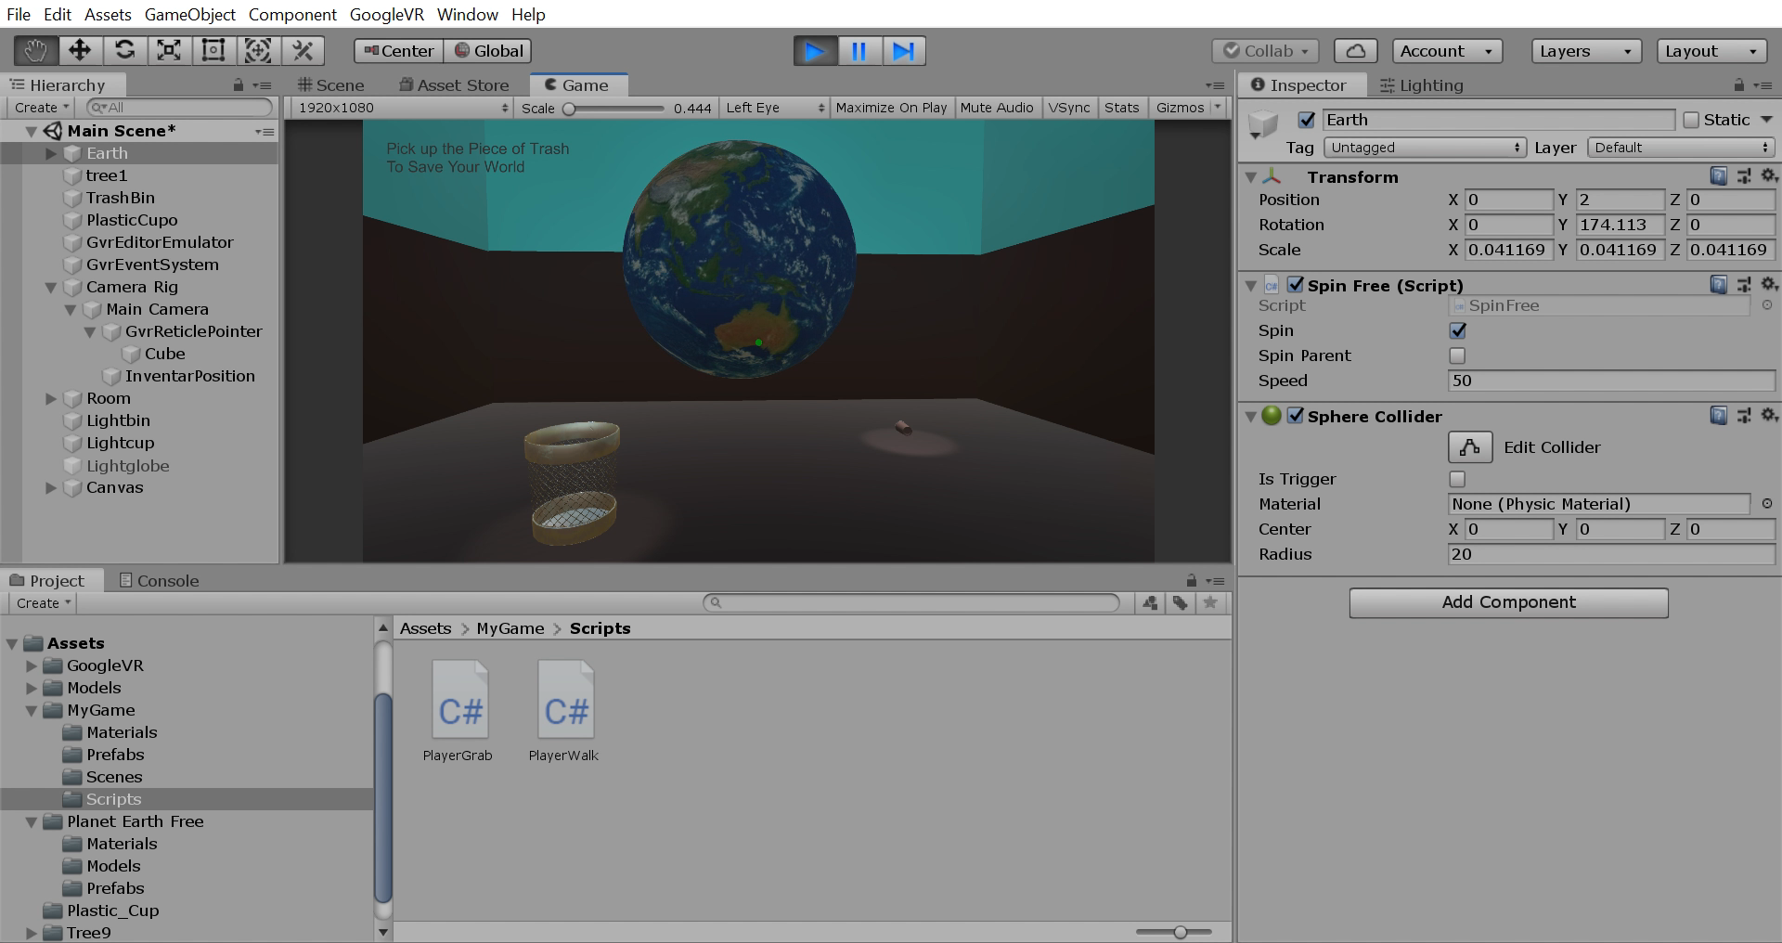
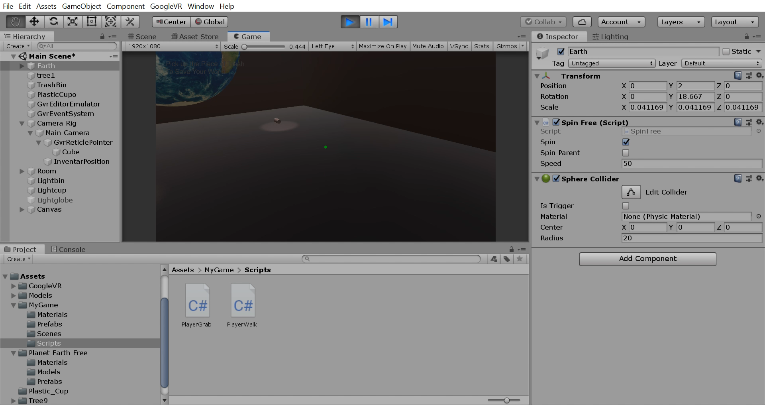
GAMEPLAY (& FAIL)

Slide 15
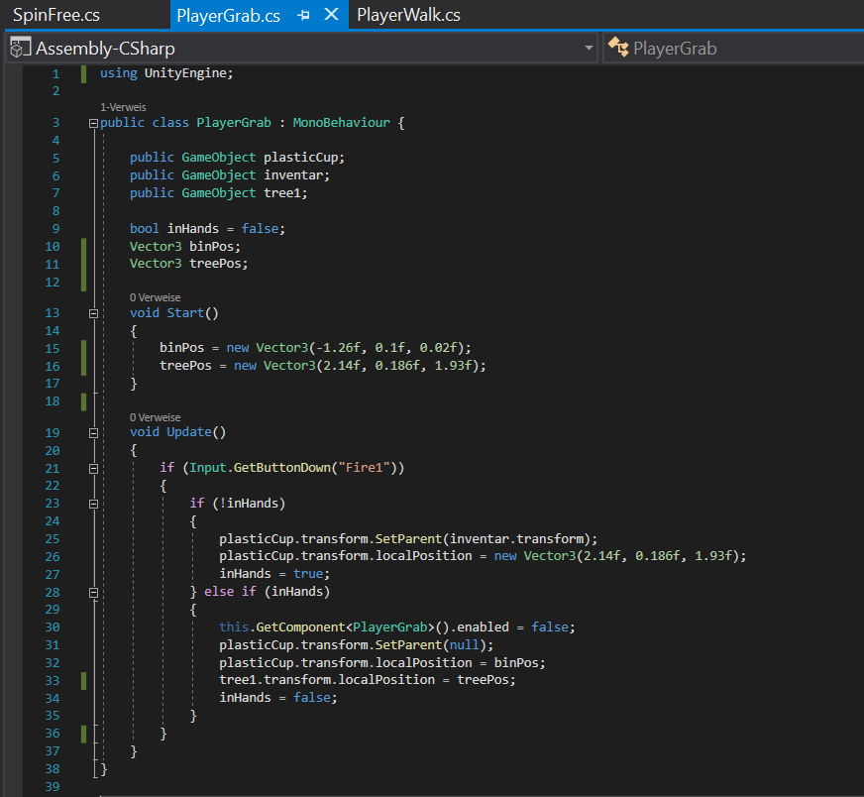
GRAB AND RELEASE (FAIL)
Cup Spawns automatically to binPos when the button is pressed
+
The player has to press the button to walk
=
Fail

Slide 16
GRAB AND RELEASE (SOLUTION)
The player has to LOOK at the bin to put the cup in it.
Problem:
idk how to do it I ran out of time

Slide 17
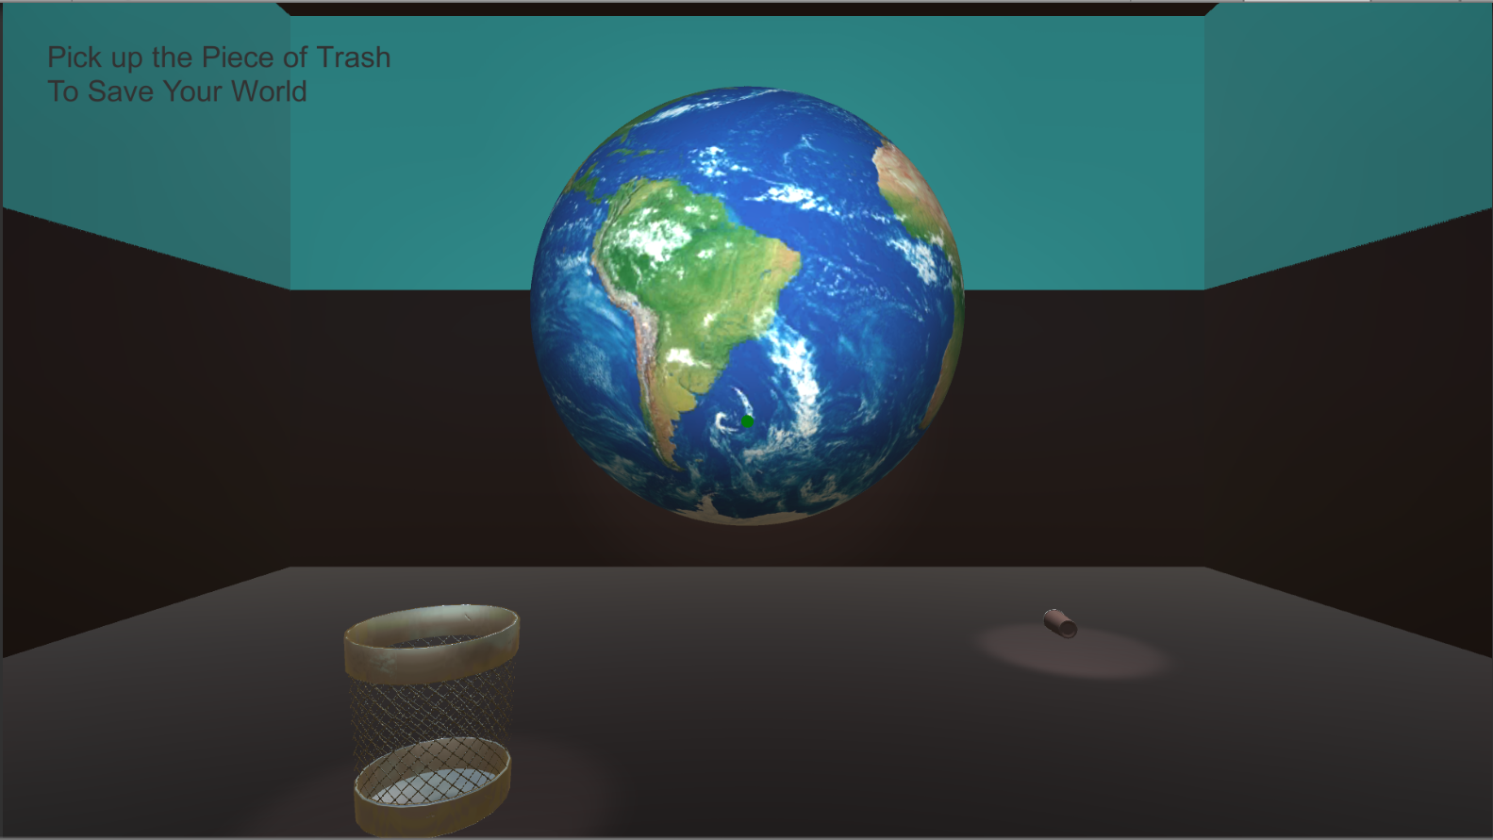
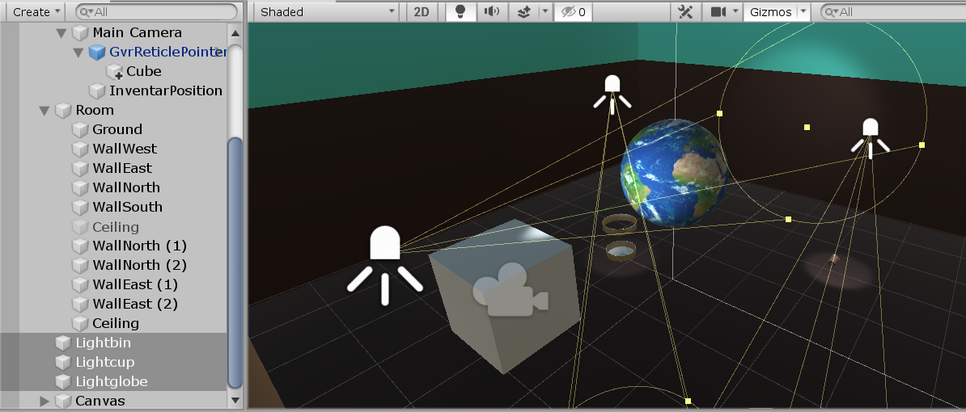
LIGHTS

Slide 18
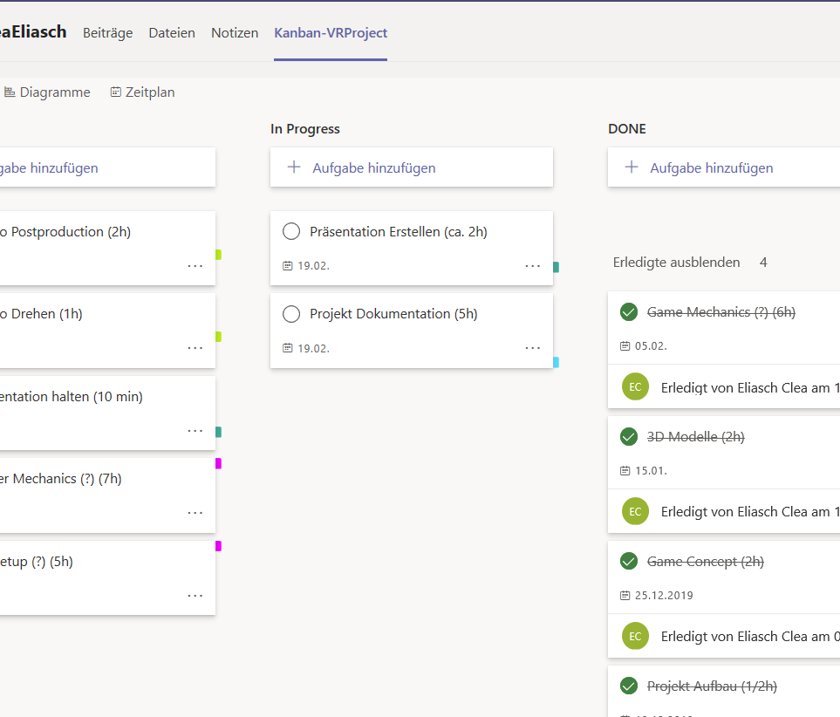
TIME MANAGEMENT
VR Setup Documentation
-> took longer than estimated
3D Models Game Mechanics Player Mechanics
-> faster than estimated
(PRETTY MUCH) IN TIME

Slide 19
THANKS!
CLEA ELIASCH
MEP 2019/20

